Slide 1
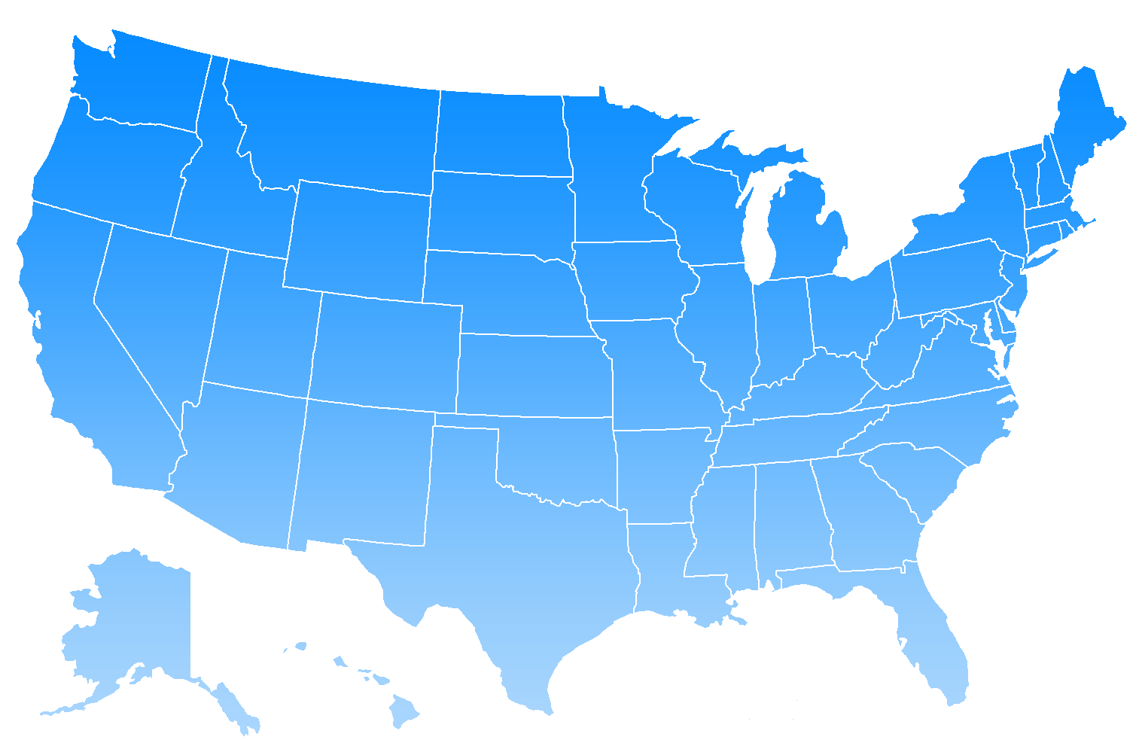

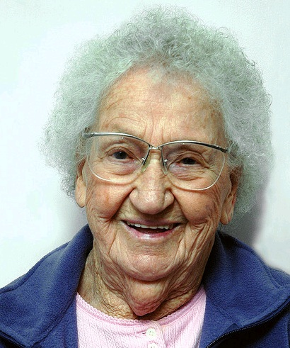





Scenario 1: Complex Medical Conditions
Theresa Olson
84 year old female
Problems:
A-Fib, Hypertension, Venous Insufficiency, Depression
Previous Visits:
Emergency – FL
Hospital – FL
Family Practice clinic – WI
Cardiology clinic – WI
Mental Health clinic – WI
Wound care clinic – WI
Minute clinic - WI
Location Query: Finding Patient Records
Notes:
INTRO SLIDE- Epic will show when telling the story about the patient to set the stage

Slide 2



Scenario 1: Translating between IHE and Direct
Surescripts
Record Locator and Exchange
XCA ITI-38 Query
Direct Message Document Request
XDR ITI-41
Provide & Register Document
Direct Message
Reply with Document
Location Query: Finding Patient Records
Notes:
Will show after HealthFusion demos the receipt/response to our Direct message

Slide 3
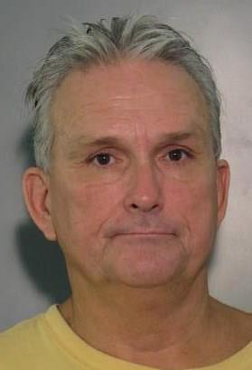


Scenario 2: Behavioral Health
Previous Visits:
Psychiatric hospital – San Diego
Mental health clinic – Los Angeles
Emergency – Los Angeles
Emergency – Santa Monica
Joseph Anderson
63 year old male
Problems:
Paranoid Schizophrenia, Diabetes
Location Query: Finding Patient Records
Notes:
INTRO SLIDE- Epic will show when telling the story about the patient to set the stage

Slide 4

Scenario 3: Translating between IHE and Direct
Surescripts
Record Locator and Exchange
Direct Message Document Request
Direct Message
Reply with Document
XCA ITI-38 Query
Direct Message Document Request
XDR ITI-41
Provide & Register Document
Direct Message
Reply with Document
Location Query: Finding Patient Records
Notes:
Will show after NetSmart demos the receipt/response to our Direct message

Slide 5
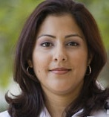



Scenario 3: Labor & Delivery
Previous Visits:
Hospital – GA
OBGYN clinic – SC
Urgent Care – FL
OBGYN clinic – GA
Jennifer Miller
36 year old female
Problems:
Pregnancy
Location Query: Finding Patient Records
Notes:
INTRO SLIDE- Epic will show when telling the story about the patient to set the stage

Slide 6
Scenario 3: Translating between IHE and Direct
Surescripts
Record Locator and Exchange
XCA ITI-38 Query
Direct Message Document Request
XDR ITI-41
Provide & Register Document
Direct Message
Reply with Document
Location Query: Finding Patient Records
Notes:
Will show after MEDITECH demos the receipt/response to our Direct message

Slide 7

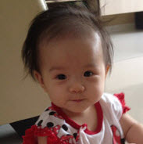
Scenario 4: Pediatric Specialist Referral
Previous Visits:
Urgent Care – WA
Urgent Care – CA
Pediatric clinic – WA
Julie Ryan
8 month old female
Problems:
Wheezing, cough, congestion, reflux
Location Query: Finding Patient Records
Notes:
INTRO SLIDE- Epic will show when telling the story about the patient to set the stage

